Slide 1

TKR COLLEGE OF ENGINEERING AND TECHNOLOGY
(Autonomous, Accredited by NAAC with ‘A’ Grade)
Department of Computer Science & Engineering
B. Tech IV Year II Semester
PROJECT PART - B

Slide 2
REVIEW-1

Slide 3
PROJECT GUIDE:
Dr. Ch. B N Lakshmi
TEAM DETAILS:
19K91A0505 Afsha
19K91A0506 A Vignesh
19K91A0549 Ch Srijan
19K91A0555 D Raju

Slide 4
PROJECT TITLE
A MODEL TO PREDICT HEART DISEASE USING MACHINE LEARNING
TEAM NO : A9
BRANCH/SEC : CSE-A

Slide 5
DESIGN

Slide 6
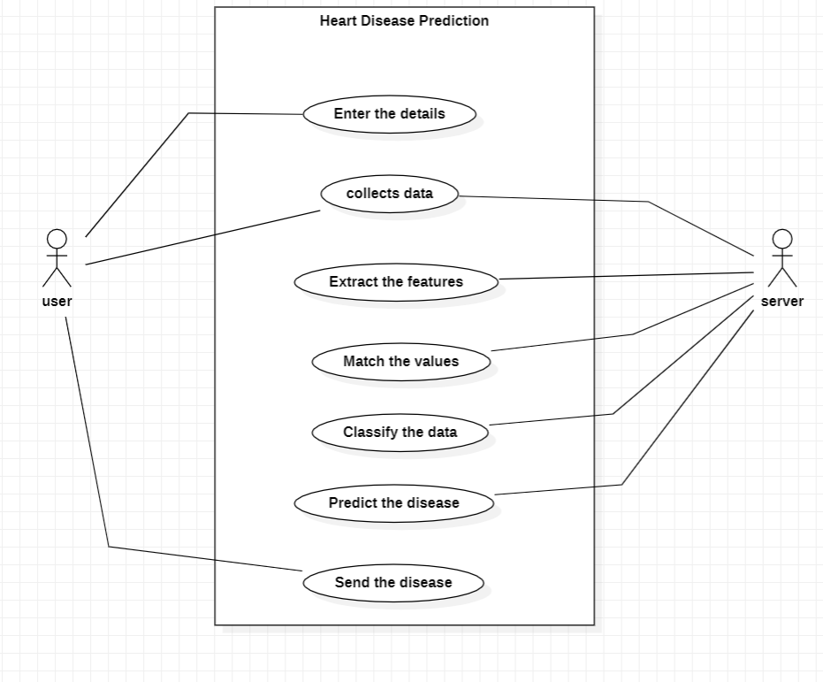
USECASE DIAGRAM

Slide 7
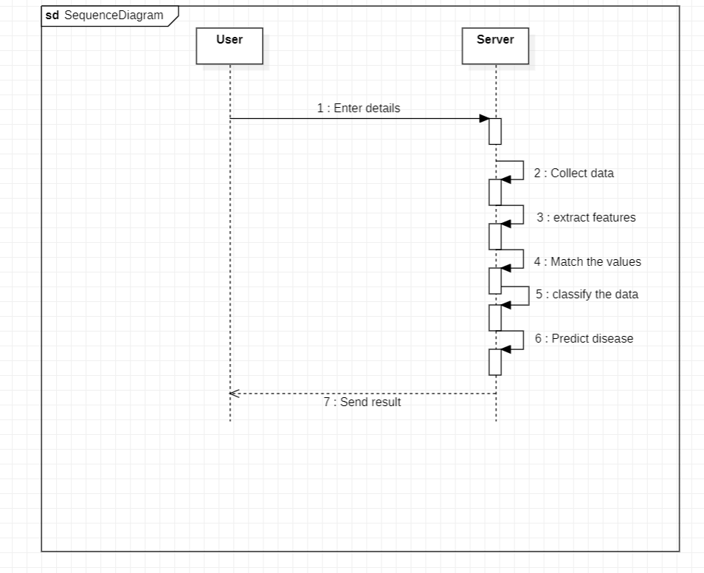
SEQUENCE DIAGRAM

Slide 8
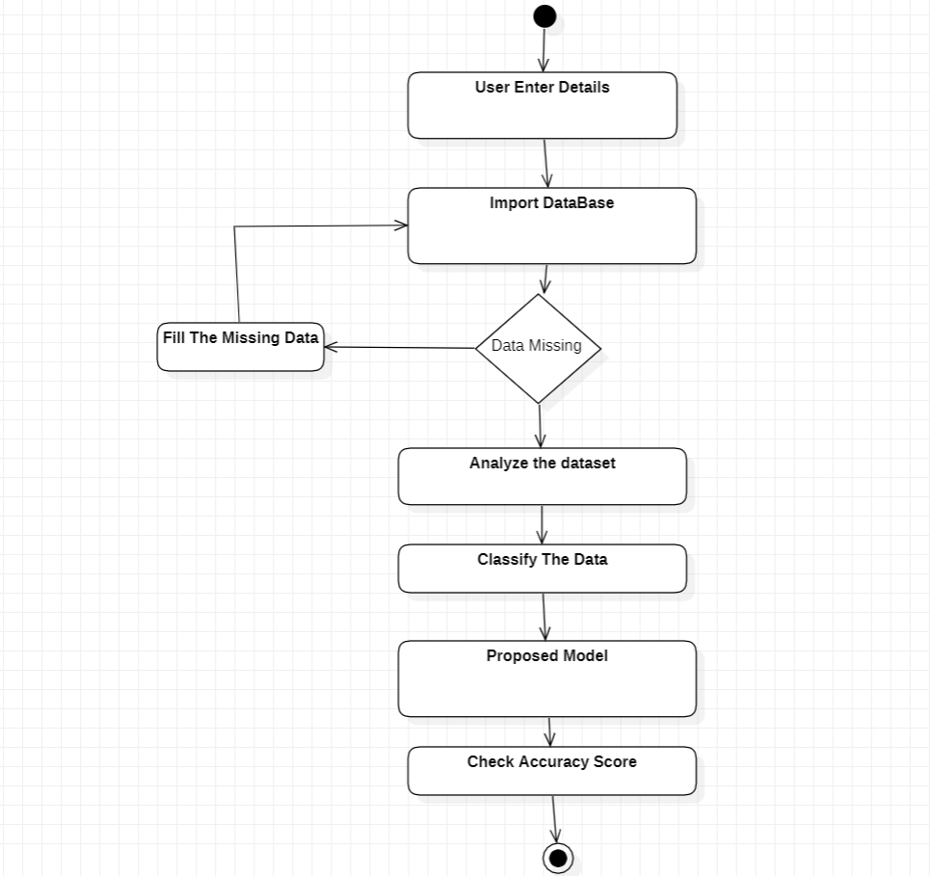
ACTIVITY DIAGRAM

Slide 9
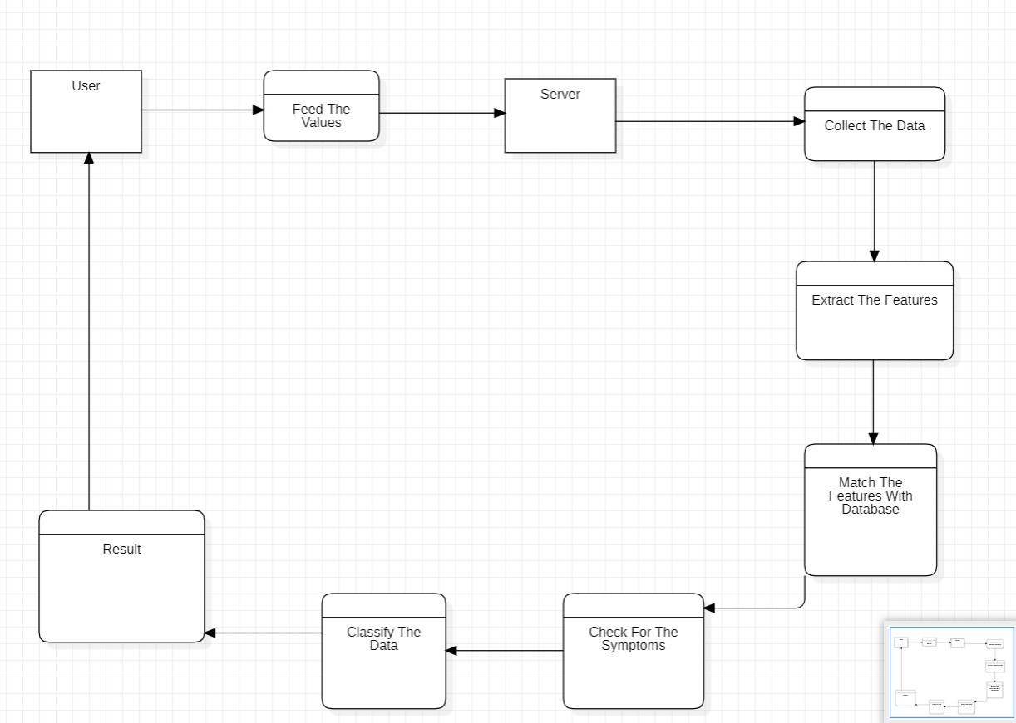
DATAFLOW
DIAGRAM

Slide 10
Thank You

